Slide 1
Adversarial Thinking Module
Lesson 3: Intro to Behavioral Game Theory
Notes:
These materials were made possible by a grant from the NSA National Cybersecurity Curriculum Program, Round 1.
All pictures and graphics used in these materials carry a Creative Commons license.
The slides are Section 508 compliant.
These materials were created by:
Seth Hamman, Ph.D.
Director, Center for the Advancement of Cybersecurity
Associate Professor of Computer Science
Cedarville University
Email: shamman@cedarville.edu
Phone: 937-766-7686
Please contact the author with any errata, suggestions for improvement, or to provide any other feedback.

Slide 2
Topics Covered in this Lesson
Behavioral Game Theory
Level-k Reasoning
The Hide and Seek Game
The Colonel Blotto Game
Notes:
This lesson is intended to be about 50-65 minutes in length, depending on the depth you desire and the amount of time you allocate to the exercises.

Slide 3
Student Learning Outcomes
Upon completion of this lesson students will be able to:
Apply level-k reasoning to derive playing strategies in strategic contests.
Upon completion of this module students will be able to:
Analyze cybersecurity from the strategic perspective of cyber adversaries.
Notes:
The Assessment Guide includes several questions that both clarify and assess this learning outcome.
Each of the three lessons in this module has one learning outcome. The learning outcomes build on one another and culminate in the overall module learning outcome.
The learning outcomes for each of the three lessons are:
Lesson 1: Students will be able to illustrate the three components of adversarial thinking for cybersecurity
Lesson 2: Students will be able to analyze a strategic scenario from a game theoretical perspective.
Lesson 3: Students will be able to apply level-k reasoning to derive playing strategies in strategic contests.
The module learning outcome is:
Students will be able to analyze cybersecurity from the strategic perspective of cyber adversaries.

Slide 4

Battle of Wits
Notes:
Slide objectives:
Engage the students attention.
Motivate the idea of behavioral game theory as a way to analyze a battle of wits.
Slide Notes:
This YouTube video was produced at Cedarville University in 2018 and carries a Creative Commons license
This is the direct link to the video:
https://youtu.be/SbXkOIzHH5w

Slide 5
Behavioral Game Theory
In Lesson 2, we learned about game theory and how it can be used to analyze strategic scenarios.
One of the underlying assumptions of game theory is player perfect rationality – this means that players behave perfectly rationally to the nth degree when making strategic choices.
In this lesson, we are going to learn about behavioral game theory
To illustrate the differences between analytical game theory (what we covered in Lesson 2) and behavioral game theory, we are going to do a quick classroom experiment…
Notes:
Slide objectives:
Segue from Lesson 2 to Lesson 3.
Introduce the notion of an alternative type of game theory – behavioral game theory.
Slide notes:
Game theory does not always make accurate predictions because of its assumption of player perfect rationality. The next exercise we do will drive home that point.

Slide 6
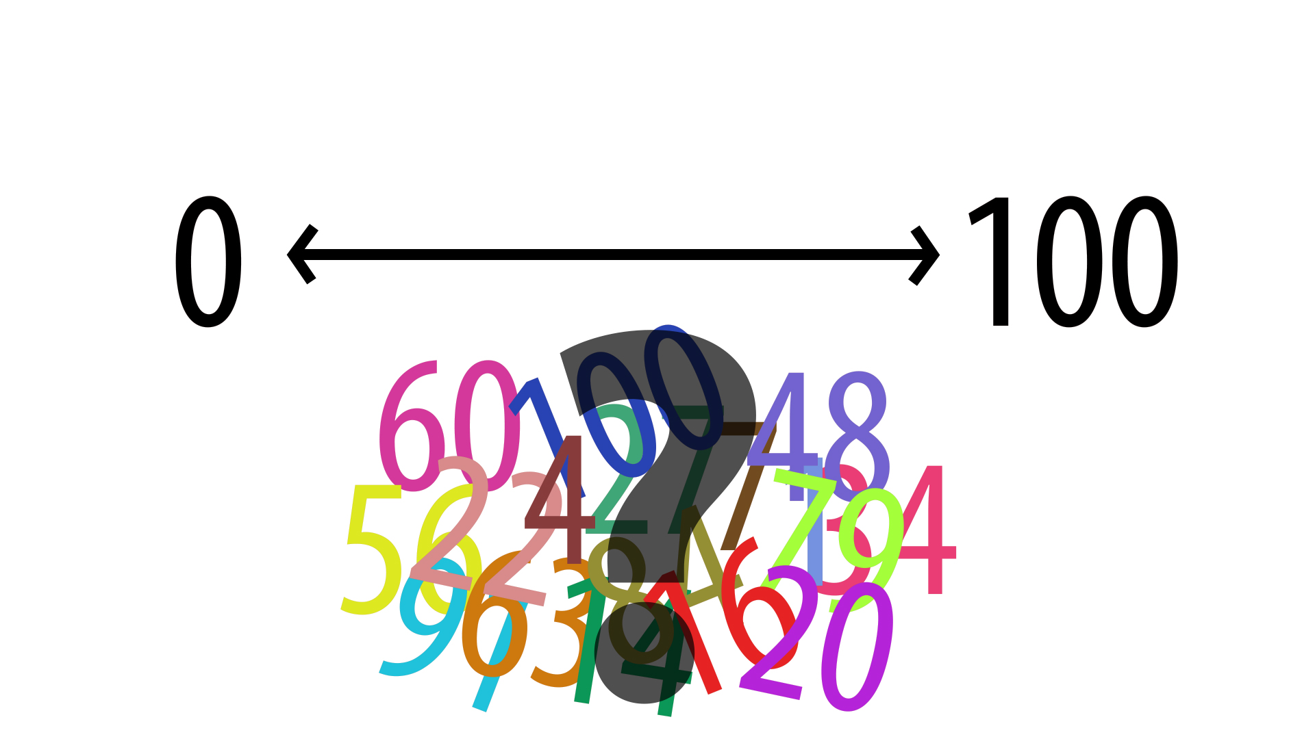
Exercise: The 2/3s Guessing Game
Notes:
Slide notes:
See The Two Thirds Guessing Game Exercise.docx and The Two Thirds Guessing Game Exercise – Instructor Notes.docx

Slide 7
2/3s Guessing Game – Analysis
This game is a little different from the games we discussed last time, but it is a game theoretical game because it has:
Players – the students in the class
Interdependent choices – the whole numbers between 0 and 100
Utility preferences – losing and winning, in that order!
The analysis of this game depends on a concept we learned in Lesson 2 called dominated strategies.
First, we consider what the highest possible winning number could be, which is the result of everybody choosing 100.
2/3s of 100 is 67 – the highest number that could ever win this game
This means, all of the numbers between 68 to 100 are dominated strategies and should never be chosen under any circumstances…
Notes:
Slide objectives:
Show the students how game theory analyzes the 2/3s Guessing Game.
Slide Notes:
In this and the next couple slides, we walk through a game theoretical analysis of the 2/3s Guessing Game.

Slide 8
2/3s Guessing Game – Analysis (cont’d)
But there is no reason to stop there…
Now we need to re-do our analysis in light of our new understanding, which is that the choices between 68 to 100 are dominated strategies.
What is the highest possible winning number now? This would result from everybody choosing 67.
2/3s of 67 is 45 – the highest number that could ever win this game.
This means, all of the numbers between 46 to 67 are also dominated strategies and should never be chosen…
Q1: Do you see where this is going – where does his process stop?
Notes:
Slide objectives:
Show the students how game theory analyzes the 2/3s Guessing Game.
Slide Notes:
This question is intended to be used as a rhetorical question, not as a brainstorming exercise. It hopefully will prompt the students to think, “What could cause this iterative process to stop?” This leads to the next slide…

Slide 9
2/3s Guessing Game – Analysis (cont’d)
This is called the successive elimination of dominated strategies.
With analytical game theory, this analysis continues all the way to the bottom.
Therefore, analytical game theory says that the “correct” choice is 0!
This is what is meant by player perfect rationality. It is assumed that all of the players will undertake a strict, logical analysis of the game, and they will all march together in their minds to the bottom.
Notes:
Slide objectives:
Show the students how game theory analyzes the 2/3s Guessing Game.
Drive home the implications of the assumption of player perfect rationality.
Slide Notes:
In the other games we have seen, there are only 1 or 2 iterations of the successive elimination of dominated strategies and then the equilibrium is reached.
There is another game called the Traveler’s Dilemma that nicely illustrates the idea of the successive elimination of dominated strategies:
https://en.wikipedia.org/wiki/Traveler%27s_dilemma

Slide 10
Behavioral Game Theory Background
There have been critics of analytical game theory from the beginning – those that maintained it was not great at predicting what real people would do in many types of real-world strategic situations.
The 2/3s Guessing Game is a great example where analytical game theory fails to provide a helpful analysis.
Therefore, for a long time, have done experiments to observe what real people actually do when faced with strategic scenarios.
This approach was initially called experimental game theory, but it eventually became known as behavioral game theory.
Notes:
Slide objectives:
Motivate interest in behavioral game theory.
Slide Notes:
The point is not to trash analytical game theory, but to show that there is an alternative that may be more helpful in some contexts.

Slide 11
Analytical vs. Behavioral Game Theory
 | Analytical | Behavioral
Method | Deductive | Inductive
Approach | Theoretical | Empirical
History | 1940’s with Von Neumann | Coined in 2000’s; built on experimental game theory
Accurate Predictions | Many repeated-play games | Many one-shot games
Paradigmatic Game | The Prisoner’s Dilemma | The 2/3s Guessing Game
Key Contribution | Nash Equilibrium | Level-k Reasoning
Notes:
Slide objectives:
Highlight the key differences between analytical game theory and behavioral game theory.
Slide Notes:
Table Row 1:
Analytical game theory starts with axioms, like player perfect rationality, and deduces conclusion from the axioms – this is a deductive approach.
Behavioral game theory starts with no axiomatic presupposition, but just observes the behavioral of real people and then draws principles from the observations – this is an inductive approach.
Table Row 2:
Analytical game theory was born in the ivory tower – its basis is theoretical.
Behavioral game theory was born in the lab – its basis is empirical observations.
Table Row 3:
Analytical game theory as an academic discipline can be traced back to the 1944 publication of Theory of Games and Economic Behavior by John von Neumann and Oskar Morgenstern.
Behavioral game theory, while budding as a discipline for a long time as part of what was known as experimental game theory, wasn’t coined until around 2000 by Colin Camerer, author of the seminal text on behavioral game theory, Behavioral Game Theory (2003).
Table Row 4:
Analytical game theory provides accurate predictions in many games, and particularly in repeated-play games. For example, if a group of people play the 2/3s Guessing Game repeatedly together, they will eventually all choose 0 like analytical game theory predicts.
Behavioral game theory provides accurate predictions in games that involve repeated back-and-forth reasoning. Because it does not assume that people are always 100% rational, and because people in reality are not always 100% rational, it does a good job of predicting where real people generally end up.
Table Rows 5 and 6:
The most famous game in game theory is the Prisoner’s Dilemma, which is associated closely with analytical game theory because it highlights so well the concept of the Nash Equilibrium.
The most famous game in behavioral game theory is the 2/3s Guessing Game because it highlights so well the concept of Level-k Reasoning.
The 2/3s Guessing Game is also called the Beauty Contest Game because it was inspired by a fictional newspaper beauty contest where readers are asked to select the woman that the most readers would find the most attractive.
Here are some good references for behavioral game theory games:
R. Nagel, “Unraveling in guessing games: An experimental study,” Amer. Econ. Rev., vol. 85, no. 5, pp. 1313–1326, 1995.
K. Basu, “The traveler’s dilemma: Paradoxes of rationality in game theory,” Amer. Econ. Rev., vol. 84, no. 2, pp. 391–395, 1994.

Slide 12
Level-k Reasoning
One of behavioral game theory’s major contributions is the concept of level-k reasoning.
Many experiments have been conducted over many years and in many places with many diverse types of people, and it has been established that most people engage in some level of level-k reasoning when faced with a strategic decision.
The levels in level-k reasoning:
Level-0 – the most obvious strategy
Level-1 – expecting your opponent to choose the most obvious strategy
Level-2 – expecting your opponent to expect you to choose the most obvious strategy
And so on – the levels go on ad infinitum
Notes:
Slide objectives:
Explain the concept of level-k reasoning from behavioral game theory
Slide Notes:
To summarize, the level-k type implicitly assumes his opponent is a level-(k - 1) type.
Even though the levels could go on forever, most research shows that people rarely if ever go beyond 3 levels.
That is why we find the following portrayal of level-k reasoning amusing…

Slide 13
Level-k Reasoning Illustrated…
Notes:
Slide objectives:
Illustrate level-k reasoning in a humorous way.
Slide Notes:
This YouTube video is copyrighted material, but it is being used under the Fair Use doctrine. The copyright holder has explicitly permitted it to remain on YouTube.
This is the direct link to the video:
https://youtu.be/K6mNJpASK-s
The Princess Bride film is a favorite among college students. This clip, usually called the Battle of Wits scene, will be familiar to most college age students in the United States:
http://www.imdb.com/title/tt0093779
The masked man is trying to save the princess from Vizzini who has kidnapped her. Because Vizzini is a genius, the noble masked man decides to engage him at his strength, which is why he proposes a battle of wits!
The amusing aspect of the video is that Vizzini goes absurdly deep in his reasoning. He only has two choices, the cup in front himself, and the cup in front of the masked man, so his reasoning causes him to go back-and-forth between the two cups. This results in the level-0 choice being the same as the level-2 choice, and the level-1 choice being the same as the level-3 choice. In many level-k reasoning situations, such a small tight loop does not exist, and the different levels lead to different choices.
Q1: What is the level-0 choice in this game?
A1:
The cup in front of oneself – this is the instinctual, gut reaction choice.

Slide 14
Level-k Reasoning and the 2/3s Guessing Game
We said earlier that analytical game theory predicts the choice of 0 in the 2/3s Guessing Game, but what about behavioral game theory?
When played with diverse groups of people of significant size, the winning number is typically in the range around 25.
Q1: What is the level-0 strategy in the 2/3s Guessing Game?
Q2: How many levels deep does the guess of 25 represent?
Notes:
Slide objectives:
Demonstrate the predictive power of level-k reasoning.
Slide Notes:
These questions are intended to be used to gauge understanding.
Here are the answers to the questions posed to students…
A1:
The correct answer to this question is debatable.
100 is the highest number, so it is the logical starting point for some people.
Other people might assume that somewhere in the range of 60 - 67 is the level-0 choice, since it is 2/3s of the highest number.
The numbers are rounded off because people are doing math quickly in their heads as the strategize.
A2:
Depending on the choice of level-0, 25 represents either 2 or 3 levels of reasoning.
The math most people do on the spot in their heads is not precise – it probably looks something like this:
100 is the level-0 choice
60 is the level-1 choice
40 is the level-2 choice
25 is the level-3 choice
Or maybe:
67 is the level-0 choice
40 is the level-1 choice
25 is the level-2 choice
Possible additional questions for students:
Does this rationale hold up for what the winner said for how she picked the number that she picked?
Did the winner engage in level-k reasoning?
What was her level-0 strategy?
How many levels deep did she go?

Slide 15
Level-k Reasoning – Real World Results
Years of experimental results show that most people engage in between 0 and 3 levels of level-k reasoning.
People may stop descending because going deeper makes their brain hurt! Or because they assume others will not keep going.
Most of the time, the level-2 strategy is a winner, which is consistent with the choice of 25 in the 2/3s Guessing Game.
In order to perform a level-k reasoning analysis, it is important to establish the level-0 strategy, which is not always obvious or possible.
Therefore, level-k reasoning is difficult to apply to some games.
Notes:
Slide objectives:
Explain the potential and the limits of level-k reasoning.
Slide Notes:
The key takeaway is that level-2 reasoning is a good place to stop in most strategic contests.
This short paper provides some good background on level-k reasoning:
A. Arad, A. Rubinstein, 2009. “Let game theory be?” Calcalist 11 May. Available from: Tel Aviv University.

Slide 16
Other Behavioral Game Theory Games…
Notes:
Slide objectives:
Motivate interest in behavioral game theory and the Hide and Seek Game.
Slide Notes:
This YouTube video is copyrighted material, but it is being used under the Fair Use doctrine. The copyright holder has explicitly permitted it to remain on YouTube.
This is the direct link to the video:
https://youtu.be/aaknyvrADVc
Numb3rs was a popular U.S. television show that featured a brilliant mathematician:
https://en.wikipedia.org/wiki/Numbers_(TV_series)
The Hide and Seek Game is a real game in behavioral game theory and the paper cited in the clip by Rubinstein, Tversky, and Heller is a real paper:
http://arielrubinstein.tau.ac.il/papers/51.pdf
Presh Talwalkar provides much more background information about the clip in his blog:
https://mindyourdecisions.com/blog/2009/12/02/game-theory-in-numb3rs-hide-and-seek/

Slide 17
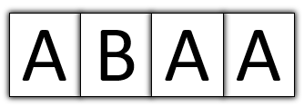
The Hide and Seek Game
You and another student are playing the following game:
Your opponent has hidden a prize in one of four boxes arranged in a row. The boxes are marked as follows:
Your goal is, of course, to find the prize. The other student’s goal is that you will not find it. You are allowed to open only one box. Which box are you going to open?
Notes:
Slide objectives:
Demonstrate the Hide and Seek Game.
Slide Notes:
Technically this game is called 4 boxes. It is from Rubinstein’s website:
http://arielrubinstein.tau.ac.il/99/gt100.html
This slide deck from Vincent Crawford provides additional information about the Hide and Seek Game:
http://dss.ucsd.edu/~vcrawfor/Hide&Seek06.ppt
You may want to have the students play a quick version of the game and tabulate the results for comparison to the next slide. The way the prompt is written, the students are placed in the role of seekers.

Slide 18
The Hide and Seek Game – Analysis
 | A | B | A | A
Hider | 16% | 18% | 45% | 22%
Seeker | 16% | 19% | 54% | 11%
Notes:
Slide objectives:
Explain the Hide and Seek Game results.
Slide Notes:
This clearly shows that there is something special about that third box! But what is it?
This game illustrates some important concepts:
Focal Point biases – when games are laid out in front of a person, they tend to predictably focus on certain things. In this game, they focus on the B box – it stands out. Therefore, it creates a kind of level-0 strategy. It is the most natural place to hide or seek something. So even in a game like this, level-k reasoning plays a role.
Rubinstein, Tversky and Heller’s major finding from the Hide and Seek Game was that people predictably avoid end points and tend to focus on the middle. The ends are undervalued and ignored. This paired with the fact that the B box stands out, is probably what makes the third box the most likely to be chosen – it is the only choice left after the ends and the B box are taken away.
There is some asymmetry between hiders and seekers – notice the rightmost box has twice as many selections for hiders than seekers. The fact that asymmetry exists in games is true for security games in general – a security game is a game theoretical game where one player is a defender and the other is an attacker. The defenders tend to start at level-0 and iterate from there, whereas the attackers tend to start at level-1 and iterate from there – in other words, the attackers start instinctively at a more strategic level. Here, it is not immediately clear which role is the defender and which role is the attacker, but it would seem to be that the hiders are starting at a slightly more strategic level – they may see themselves like attackers in that they naturally, instinctively feel that they must outwit the seekers.
Game theory predicts that the seekers will win 25% of the time, since there are 4 choices, all equally likely. But experiments show that seekers win 33% of the time. Game theory doesn’t take into account the fact that not all of the choices are equally likely – but behavioral game theory does!
These results are from:
A. Rubinstein. (Oct. 1999). Experience From a Course in Game Theory: Pre and Post-Class Problem Sets as a Didactic Device:
http://arielrubinstein.tau.ac.il/99/gt100.html
Here is Rubinstein’s description:
“4_boxes is a repetition of an experiment conducted by Rubinstein, Tversky and Heller (1996). The subjects were asked to hide a treasure in one of four boxes placed in a row and labeled A,B,A,A. The seeker is able to open only one box. In 1998 the subjects were assigned the role of the seeker. The distribution of answers (16%, 19%, 54%, 11%) is strongly biased towards the central A box, avoiding the edges. These results were even more pronounced than those of the original experiment (13%, 31%, 45%, 11%). In 1999 the subjects were assigned the role of the hider. Once again, the results (16%, 18%, 45%, 22%) were similar to the results (9%, 36%, 40%, 15%) obtained originally. Where a random seeker of the 98's class was playing the game against a random player of the 99's class the chances that he would find the prize was 33%, much above the game theoretic "prediction" of 25%. By the way, the presentation of the results in class created a feeling of real ‘discovery’.”

Slide 19
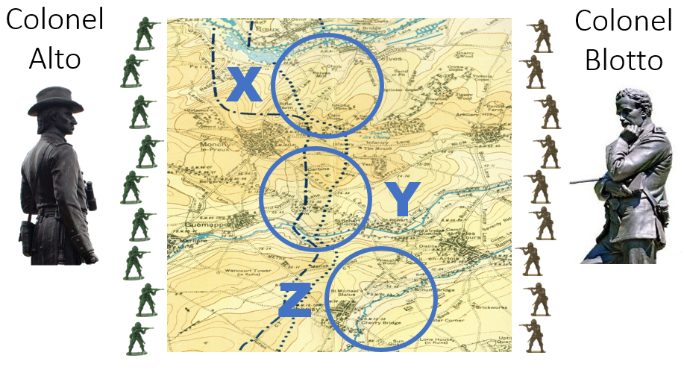
The Colonel Blotto Game
Notes:
Slide objectives:
Introduce the Colonel Blotto Game.
Slide Notes:
In this game, two players allocate soldiers to battlefields, and the player who has allocated the most soldiers to a particular battlefield, wins the battlefield. It does not matter how many more soldiers one places on a battlefield, whether it is 1 more or 100 more, the result is the same, a victory in that battlefield. Therefore, it pays to win with very small margins because this provides more resources to allocate other places.
In the example shown here, there are 3 battlefields labeled X, Y, and Z. Assume that they are all equally valuable (e.g., 1 point each).
Both players also have 9 soldiers to allocate, and they can divvy them up anyway that they want between the 3 battlefields.
Q1: What is the level-0 strategy in this game setup?
A1:
Since 3 x 3 = 9, the most obvious, instinctual strategy is to allocate 3 soldiers to each battlefield. This is known as the equal allocation strategy, which in this case, since the battlefields are all equally valuable, is the same as the proportional allocation strategy.
Further Background:
In 1921 French mathematician Émile Borel outlined a strategic contest that later became known as the Colonel Blotto Game. In the classic Colonel Blotto Game, two colonels, A and B, compete over K independent battlefields of total value U. The colonels control M and N soldiers, respectively, and they must distribute them over the K battlefields without knowing their opponent’s allocations (in the cover of darkness as the eponymous construction goes). Their choices are revealed simultaneously (continuing the illustration, at dawn), and whichever colonel has allocated the most soldiers to a particular battlefield wins that battlefield’s utility. In the case of a tie, the two sides split the utility evenly. Each colonel’s goal is to maximize his own utility.
The Colonel Blotto Game is a fundamental model of strategic resource allocation and is one of the oldest games in game theory. Economists have applied it to the analysis of electoral competitions in which the candidates (the colonels) compete over states (battlefields) and must decide how much advertising money (soldiers) to spend on each state. The quantity of each state’s electoral votes determines its utility. The candidates’ budgets are limited and they do not know ahead of time how much advertising money their opponent has allocated to each state, but the idea is that he who allocates the most money to a particular state will win that state. Another example is two firms engaged in drug research and development. Each must decide how many resources to spend on developing a particular drug. How should firms allocate their R&D budgets to projects? Will they concentrate their expenditures on only a few projects or will they invest in every potential patent?
There are many variations of the basic Colonel Blotto Game. The colonels may have the same amount of soldiers or different amounts. The values of the battlefields may be homogenous or heterogeneous. The colonels may agree or disagree on the values of the battlefields. There are also different ways to resolve ties, including denoting a default winner in all cases, splitting the utility between the colonels, or not awarding the utility to either colonel. Arad and Rubinstein have demonstrated that when people play the Colonel Blotto Game, they exhibit level-k reasoning.
There is a book chapter on applying the Colonel Blotto Game and level-k reasoning to cyber-physical systems protection:
S. Hamman, K. Hopkinson, and L. McCarty, “Applying behavioral game theory to cyber-physical systems protection planning,” in Cyber-physical systems: foundations, principles, and applications, Elsevier, Academic Press, 2017.
Here are some additional references:
O. Gross and R. Wagner, “A Continuous Colonel Blotto Game,” RAND RM-408, RAND Corporation, Santa Monica, CA, 1950.
B. Roberson, “The Colonel Blotto game,” Economic Theory, vol. 29, no. 1, pp. 1-24, 2006.
D. Kvasov, "Contests with limited resources," Journal of Economic Theory, vol. 136, no. 1, pp. 738-748, 2007.
A. Arad and A. Rubinstein, “Multi-dimensional iterative reasoning in action: The case of the Colonel Blotto game,” Journal of Economic Behavior Organization, vol. 84, no. 2, pp. 571–585, 2012.

Slide 20
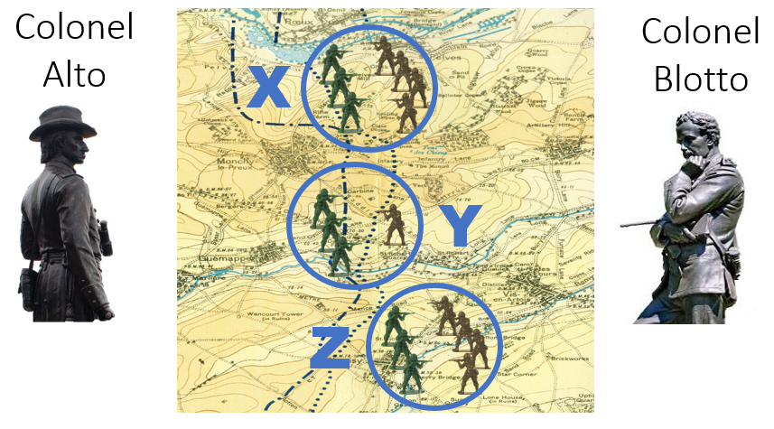
The Colonel Blotto Game
Notes:
Slide objectives:
Analyze the strategy involved in a Colonel Blotto Game.
Slide Notes:
Here we see that Colonel Alto has played the level-0 strategy and has allocated 3 soldiers to each battlefield, 3, 3, 3.
Colonel Blotto, anticipating this, allocates 4, 1, 4. Colonel Blotto could be said to have played a level-1 strategy.

Slide 21
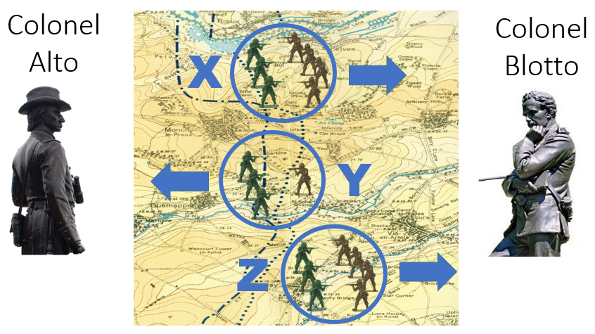
The Colonel Blotto Game
Notes:
Slide objectives:
Analyze the strategy involved in a Colonel Blotto Game.
Slide Notes:
Therefore, Colonel Blotto has won 2 of the 3 battlefields, which is the best he could have done – when both players are equally matched as in this setup, it is not possible to win all of the battlefields.
Q1: What would be the level-2 strategy be in this game?
A1:
In order to beat Colonel Blotto, you’d have to allocate 5 soldiers to one of the battlefields, and maybe 2 and 2 to the others. This would be an allocation of 5, 2, 2.
However, levels are not immediately identifiable in the Colonel Blotto Game. For one, how do you know which battlefield to allocate the 5 soldiers to? If you guess wrong, you will only win 1 of the 3 battles.
In the next exercise, we will play a cyber themed Colonel Blotto Game…

Slide 22
Exercise: DDoS
Website | A | B | C | D | E | F
Value | 1 | 1 | 1 | 1 | 1 | 1
Protection (must sum to 120) | ? | ? | ? | ? | ? | ?
Notes:
Slide objectives:
Provide the students an opportunity to apply behavioral game theory to a game.
Slide notes:
See DDoS Attack Exercise.docx and DDoS Attack Exercise – Instructor Notes.docx

Slide 23
DDoS - Analysis
Website | A | B | C | D | E | F
Value | 1 | 1 | 1 | 1 | 1 | 1
Protection (must sum to 120) | 2 | 31 | 31 | 31 | 23 | 2
Notes:
Slide objectives:
Provide the students an opportunity to apply behavioral game theory to a game.
Slide Notes:
Have the students score their allocations against this strategy. Ask the class if anybody won 4 or more battlefields against this allocation – i.e., if anybody beat this strategy.
Remember, abandoned sites do not receive any points, and ties do not receive any points.
It is likely that most students did not win at least 4 battlefields against this particularly strong strategy. This strategy was the winning strategy when this exact same Colonel Blotto Game setup was played with thousands of players. In the experiment, the game was not the cyber-themed Colonel Blotto Game we played, but the number of battlefields (6), the values of battlefields (1 point each), and the number of soldiers to allocate (120) was the same.
Q1: What are the features that make this strategy so competitive?
A1:
Notice how focal point biases were utilized. The ends are assumed to be undervalued, so he placed the fewest resources on the ends and was able to win them cheaply against many players who either abandoned them altogether, or who placed only 1 soldier against them.
Level-k reasoning was employed in the choice of 2 soldiers on the ends to beat players who only used 1 soldier to defend them. This is probably a level-2 strategy.
Level-k reasoning was also employed in the choices of 31 and 23 in the middle battlefields. Remember, in the Colonel Blotto Game, the equal allocation strategy, which is 20 on each battlefield for this setup, is the level-0 strategy. So 31 and 23 both represent increased levels. Perhaps 31 is level-2, because it may proceed from 20 to 30 to 31. Similarly, 23 could be perceived as level-3, going from 20, to 21, to 22, to 23.
The choice to concentrate resources on 4 of the battlefields is also a level-k choice. The level-1 strategy, like we saw in the game with 3 battlefields, would be to focus on n-1 of the battlefields. Focusing on 4 battlefields in this game is a level-2 choice.
There aren’t many wasted soldiers – the allocations were designed to win by small margins, which ended up being a very efficient use of soldiers.
The big takeaway is that at least in this game, level-k reasoning is relevant in multiple dimensions. It factors into which battlefields, how many battlefields, how many soldiers on abandoned battlefields, and how many soldiers on focused battlefields.
It is important in level-k reasoning to not descend too deep – it is like overthinking the problem! Going to higher levels of reasoning in this game leads to wasted resources and an overall inferior result.
This strategy and the explanation of the winning strategy that follows is taken from this paper:
A. Arad and A. Rubinstein, “Multi-dimensional iterative reasoning in action: The case of the Colonel Blotto game,” Journal of Economic Behavior Organization, vol. 84, no. 2, pp. 571–585, 2012.
The winner explained his allocations this way:
“In the first stage, I decided that I would “surrender” on two battlefields, but not so easily. I thought that other people would assign a few troops to some of the battlefields and perhaps none to others. Thus, I figured I could win on an “abandoned” battlefield at the low cost of only one troop. Eventually, I decided to deploy two troops on the weak battlefields in order to defeat anyone who thought like me and had placed one troop on each of the weak battlefields. I was left with 116 troops to allocate among four battlefields, which is an average of 29 troops per battlefield. I decided to reinforce three of the four remaining battlefields with two troops – that is, to deploy 31 troops – in order to defeat those who had allocated the remaining troops equally. In this way, I would also defeat those who had allocated 30 troops to each of the four battlefields. With respect to the location of the weak battlefields, it seemed logical to me that the weak battlefields would be on the edges.”

Slide 24
Conclusion
Behavioral game theory is a better predictor of a person’s strategic choices than analytical game theory for many situations.
Level-k reasoning is a helpful way to approach strategic contests.
Identifying the level-0 strategy is very important but is not always possible.
2 to 3 levels of reasoning performs very well in most games.
Going exactly one level deeper than one’s opponent is optimal.
What does all of this have to do with cybersecurity again?
Notes:
Slide objectives:
Providing a summary of the most important points of the lesson
Slide notes:
The last question segues into the final, overall wrap-up slide…

Slide 25
Module Conclusion
Cybersecurity, at its essence, is an adversarial conflict – without adversaries, there is no such thing as cybersecurity.
Therefore, adversarial thinking is central to cybersecurity.
Learning about game theory in a cybersecurity class makes sense. This is because adversarial thinking requires strategic reasoning, and game theory is the study of strategic reasoning
The major takeaway from game theory is that one must consider strategic situations primarily from the perspective of the adversary, not primarily from one’s own perspective.
The overarching goal of this module is two-fold:
To make indelible the association between strategic reasoning and cybersecurity
To produce enduing strategic-mindedness in cybersecurity students
Notes:
Slide objectives:
Providing a summary of the most important points of the entire module
Slide notes:
This is the entire module in a slide.
At the conclusion of the module, it is appropriate to re-administer the Data Breach exercise. This pretest-posttest provides a nice assessment of the progress made by the students in their adversarial thinking abilities. After the posttest is scored, you might also consider going over the results of the Data Breach exercise with the students as a final wrap-up. Seeing the days that the attack subjects chose is illuminating, and it helps to solidify the main points of the module. This could also provide a good opportunity for discussion and for the students to provide feedback.
Please provide questions, comments, and feedback to shamman@cedarville.edu. Your input is very much appreciated!

Slide 26
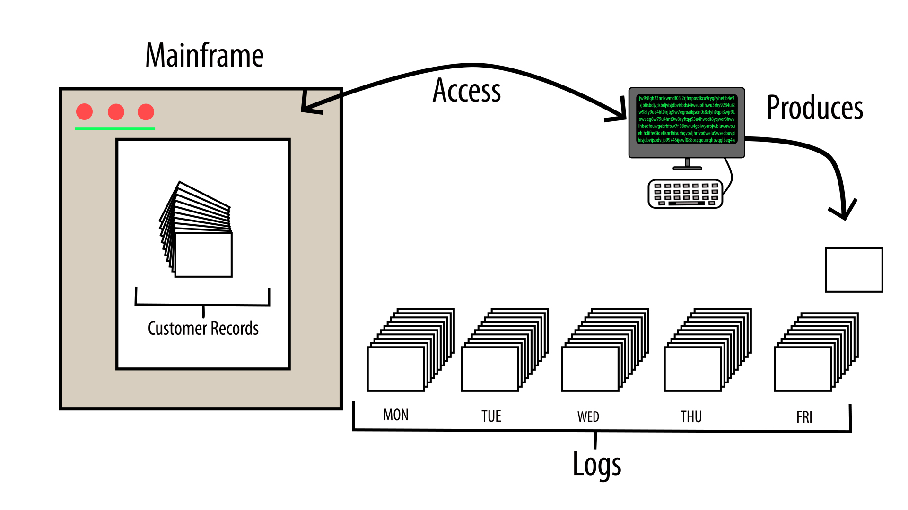
Exercise: Data Breach - Posttest
Notes:
Slide notes:
See Data Breach Exercise.docx and Data Breach Exercise Posttest – Instructor Notes.docx

